Slide 1
CTIS
1. Viewer role used by a monitor
2. Documents in Trial Master File (TMF)
Pernille Ask Aabo
GCP-unit Copenhagen
NORM Meeting - 25 October 2024

Slide 2
CTIS viewer role
Allows user to
view structured data
view documents
download documents
Purpose:
  Access to sponsors approved documents
  Access documents that are not in CTIS public (e.g. cover letter, RFI, assessment report)
  New public CTIS 18 June 2024 with fewer documents
  Prepare before initiation visits
  See ongoing/approved modifications during the trial

Slide 3
How to get access to CTIS as viewer
Create login to CTIS (via EMA account)
  Fill in registration form https://register.ema.europa.eu/identityiq/external/registration.jsf#/register
Create a 2-factor approval: https://register.ema.europa.eu/identityiq/help/signin.html
  Mobile phone app: (Microsoft Authentication)
Send your EMA user ID to sponsor
The role ”CT Admin” (e.g. sponsor or delegated person) assign the viewer role to monitor in CTIS

Slide 4
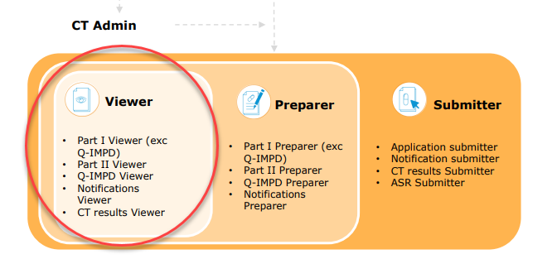
Viewer-roles
CT Admin (sponsor or delegated) must choose the ”viewer-roles” to monitor:
  Part I viewer (exc Q-IMPD)
  Part II viewer
  Q-IMPD viewer
  Notification viewer
  CT Results viewer (not relevant for monitor?)

Slide 5
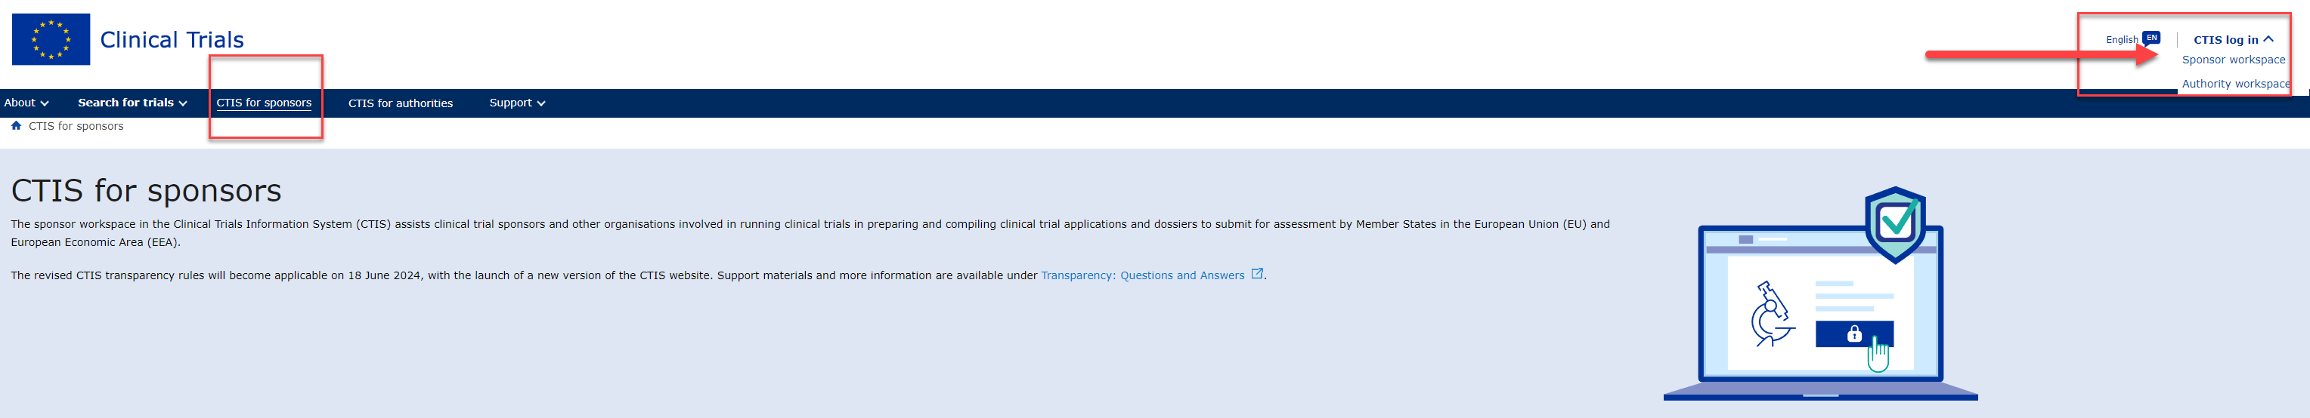
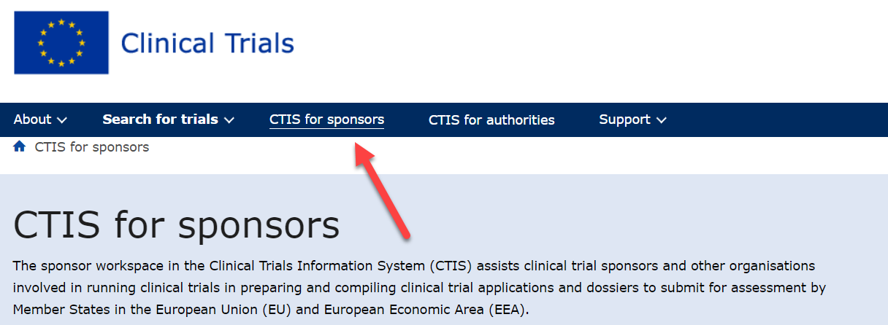
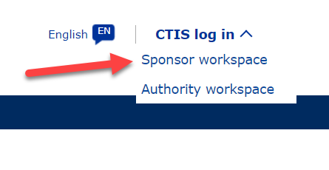
CTIS sponsors workspace:
https://euclinicaltrials.eu/ctis-for-sponsors/

Slide 6
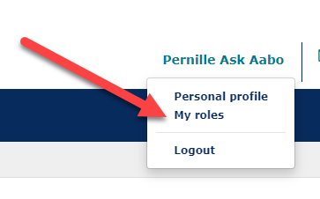
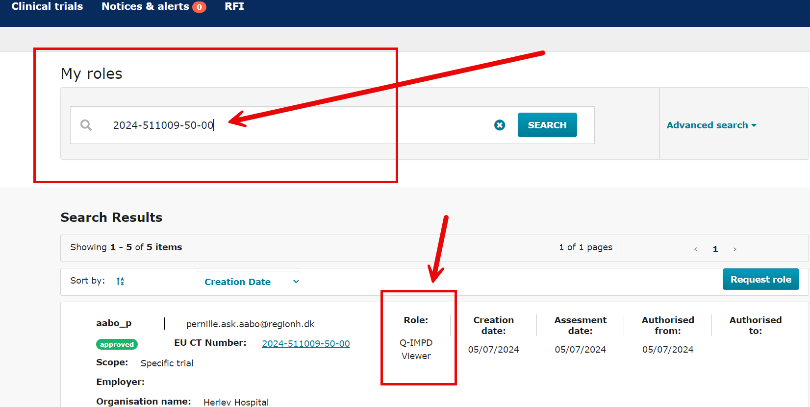
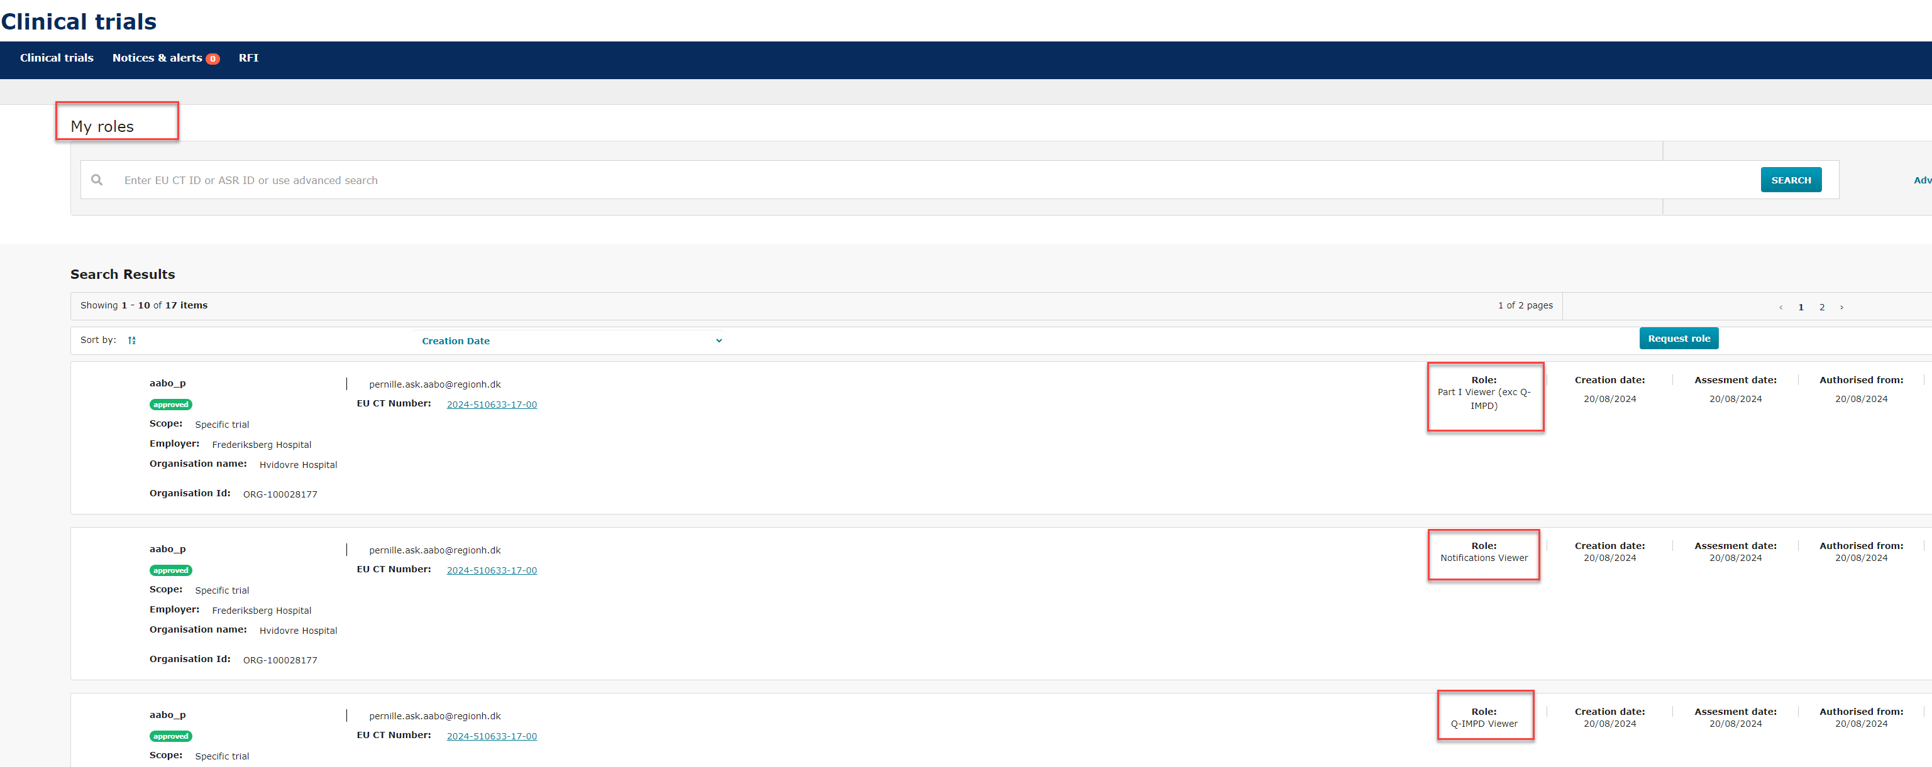
Overview of your ”viewer roles”
See the trials you have ”viewer access” to:
  By entering ”EU CT no” OR go to "My roles”

Slide 7
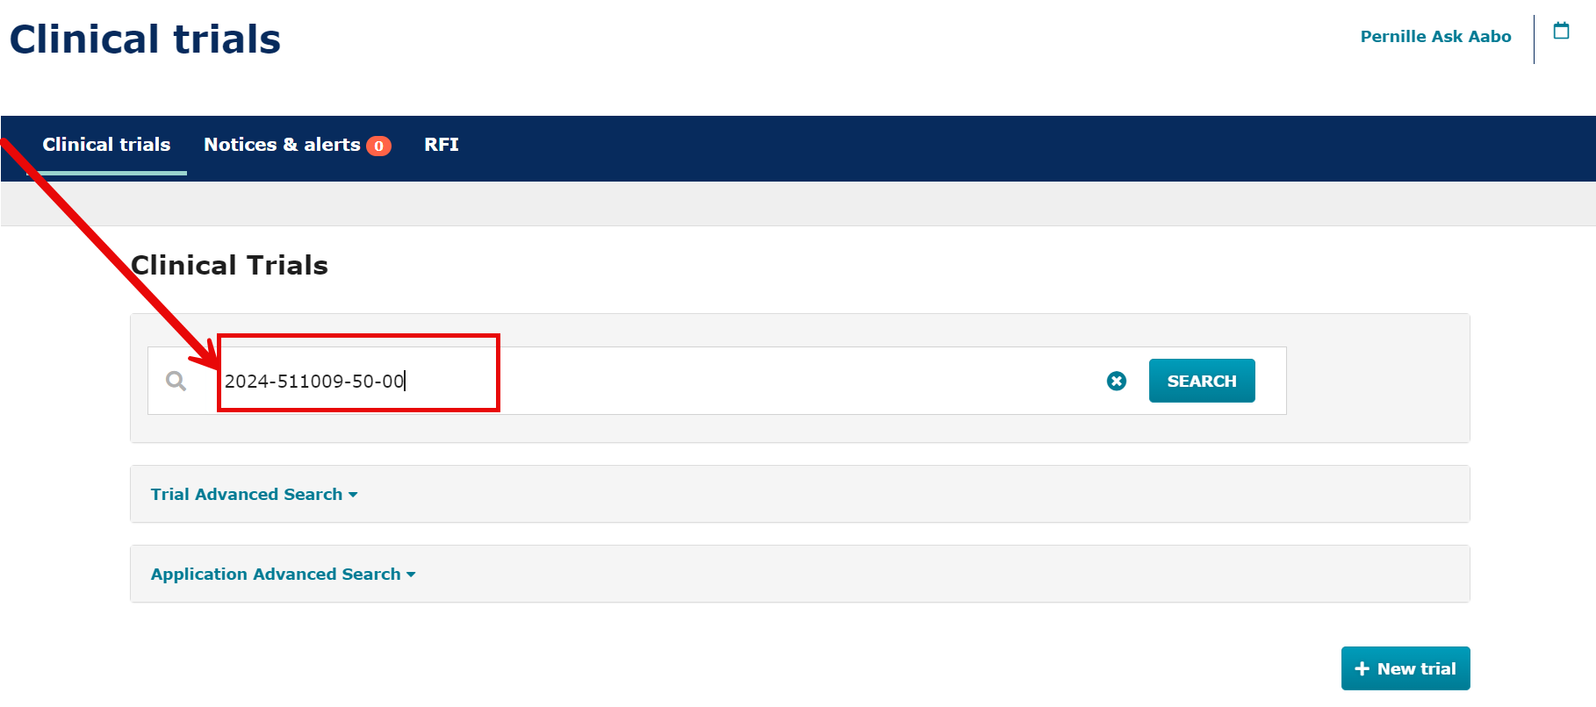
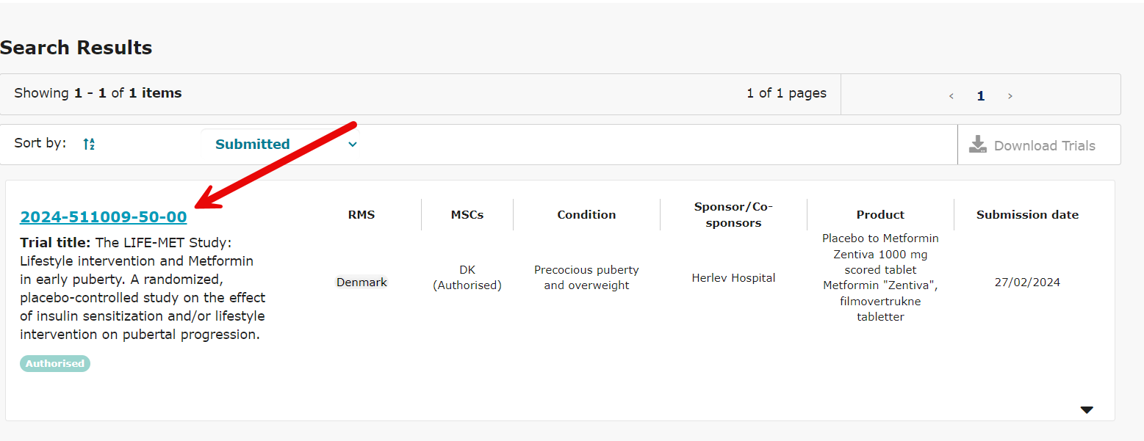
  Find the trial
  Search for the EU CT no
  The trial is shown if you scroll down

Slide 8
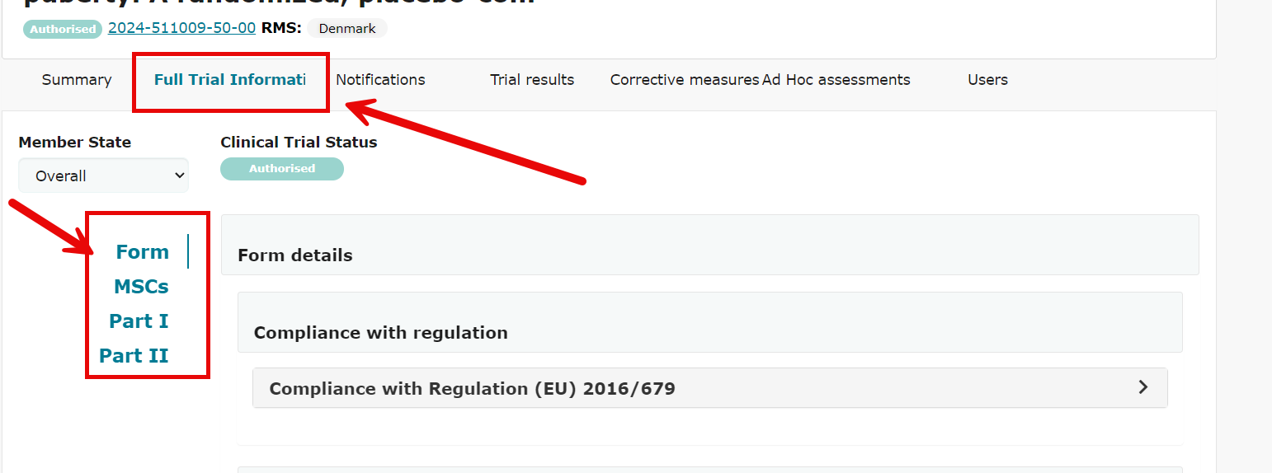
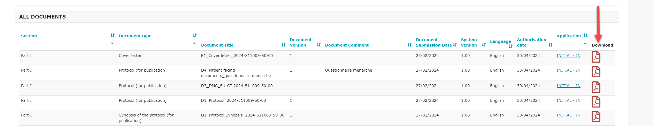
Find documents
  Choose Part I/II or the structured data at ”Full Trial Information”
  Open/download documents at the right

Slide 9
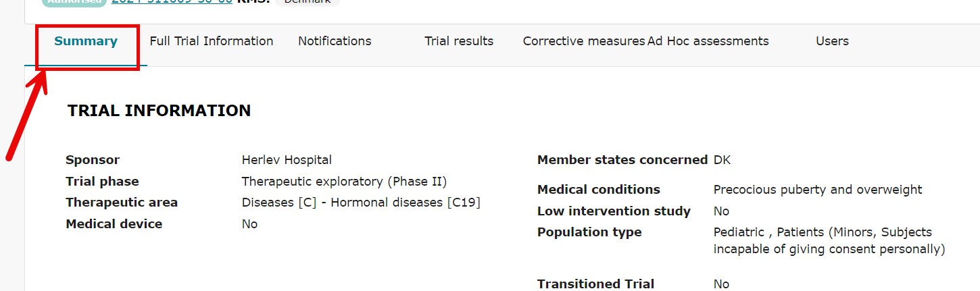
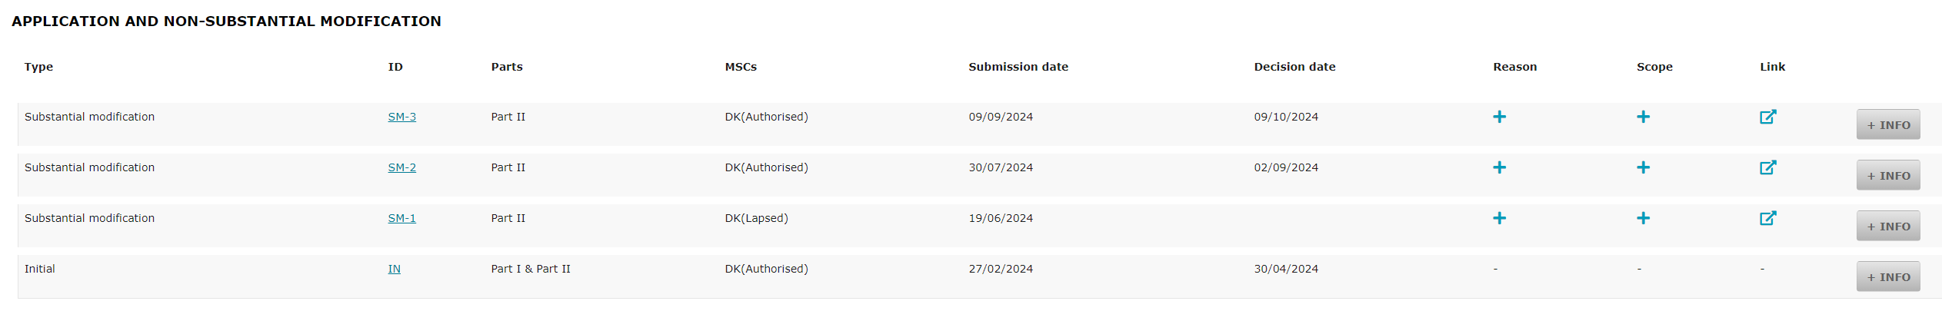
Find a specific application
  Go to ”Summary”
  Scroll down and see applications

Slide 10
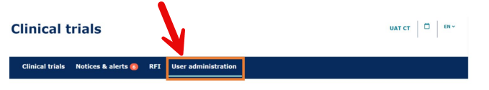
How `CT-Admin´ assign the role:
(can be sent to sponsor by mail)
How to assign business role to users within the organisation
After a new CTA is created, the CT Admin can assign business roles for that specific trial
After the CT Admin is approved, users can log in to CTIS and click the User administration tab.
2. Click on the ‘Assign new role’ button.
3. Fill in the information about the business role to be assigned to users within the organisation and click on the ‘Assign’ button.
When a role is assigned, users must log out and log in again, in order to have the role assigned to them in the system.

Slide 11
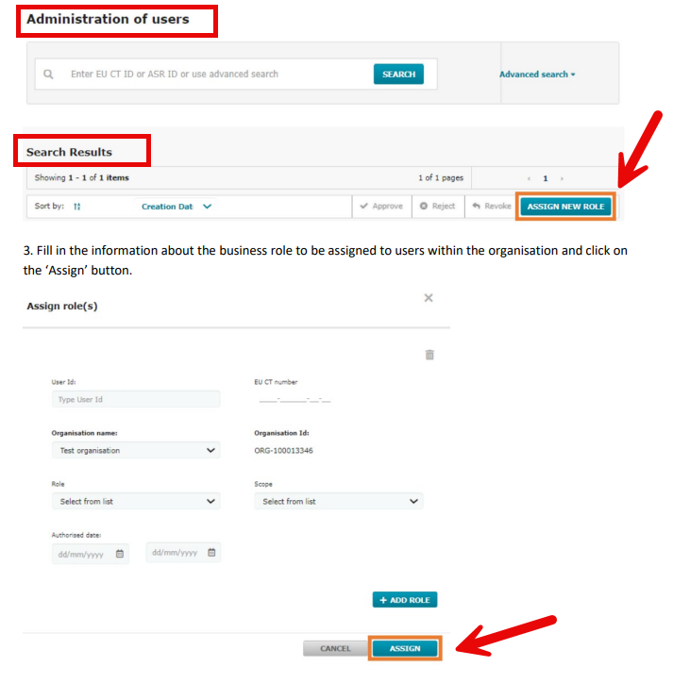
How `CT-Admin´ assign the role: :
  Roles:
  Part I viewer (exc Q-IMPD)
  Part II viewer
  Q-IMPD viewer
  Notification viewer
CT Admin need:
Monitor EMA user name
Monitor E-mail
EU CT no on trial
Click ”+Add role” and assign all four roles before ”Assign”.

Slide 12
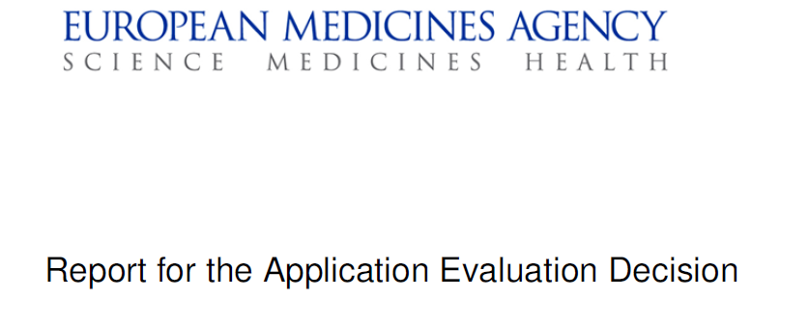
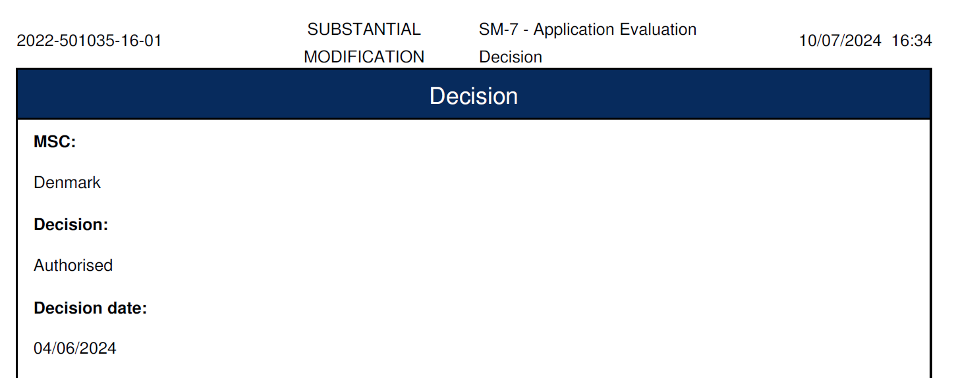
Approval documents from CTIS in TMF (DK):
Initial Application and Substantial Modification (SM):
Sponsor:
Report for the Application Evaluation Decision
Part I assessment report except quality
Part II Final assessment report
RFI sponsor answers
Investigator
Report for the Application Evaluation Decision (Report for AED)
Sponsor send an e-mail to all sites with all the documents approved (e.g. report for AED, new protocol, ICF etc.)

Slide 13
What is required in TMF from CTIS?
Norway
Sweden
Finland
Iceland

Slide 14
How do monitor and sites see which documents are approved in CTIS?
Norway
Sweden
Finland
Iceland

