Slide 1
NORM 2024
Sponsor Oversight
25 October 2024
Carina Alvfors, Project Manager Clinical Trials
Section for Clinical Research
UCR – Uppsala Clinical Research Center
Notes:
Genom att förstå vilka krav en Sponsor har

Slide 2


Agenda
What and why?
Regulatory documents
Does this concern us?
Requirements for the sponsor
Reporting obligations
Inspection findings
Oversight findings
A glimpse of ICH-GCP E6 draft R3

Slide 3
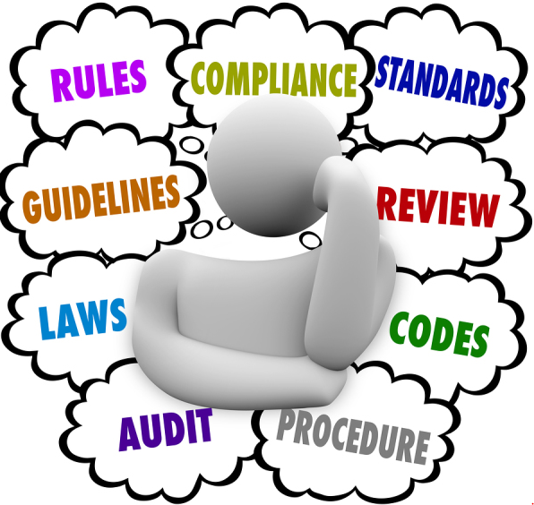
What is Sponsor Oversight?
The processes and regular activities
that Sponsor uses, to fulfil their obligation to ensure that delegated/”outsourced” tasks are carried out correctly.
(This also applies to third party contractor).
Notes:
Effektivitet = spar både tid och pengar

Slide 4
Why Sponsor Oversight?
To ensure safety and integrity of study subjects
To ensure robust data
The regulations have
been updated to clarify
Sponsor’s obligation to
maintain Oversight
during the study process as part of the
overall QC strategy.
Notes:
Effektivitet = spar både tid och pengar

Slide 5
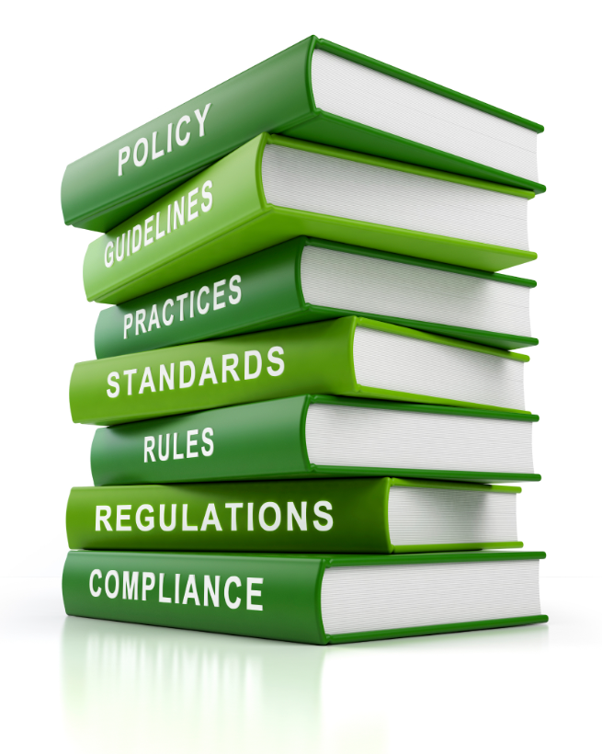
Regulatory documents that control Sponsor Oversight
Europe: ICH-GCP E6 R2 - soon R3…
CTR 536/2014
UK: MHRA 2004/1031 Regulation 3
US: Title 21 CFR 312.50: General responsibilities of sponsor
MHR = the Medicines and Healthcare Products Regulatory Agency
CFR = Code of Federal Regulations

Slide 6

In the long-run, this will lead to…
More efficient studies
  Proactivity through good processes and preventive measures
  Early identification of non-compliance → corrective actions
  Continuous improvements
Inspection readiness
Keywords:
avoid unnecessary complexity,
fitness for purpose
risk proportionality…
Notes:
Tidsbesparande
Kanske snabbare till mål
Högre kvalitet
Billigare

Slide 7

Does this concern us?
Through understanding what Sponsor Oversight means, we can…
Ask questions about the Sponsor’s expectations of us – and make sure that this is addressed in the contract and included it in the execution.
Guide and assist our academic Sponsors to a reasonable level of oversight.
Inspiration
  Can we have better Oversight of our subcontractors?
  How do we apply and maintain risk assessment?
  Can we improve any processes to be inspection ready?
Notes:
Ingen oversight = critical finding vid inspektion.

Slide 8
Requirements for the Sponsor to meet regulatory demands and avoid critical inspection findings.
Protocol development
IMP Management
Data Management
Choice of Vendor/Site
Robust data
Patient safety
Control of systems
Control of data flow
Data validation
Study design
Treatment compliance
Safety reporting
Risk based approach
GCP Compliance
QC and QA
Clear Roles and Responsibilities
Tracking – Monitoring – Performance
Co-monitoring
TMF (inspection ready)
Validation/Audit/Assessments
Contract – Plans – Manuals – Logs
SOPs
Risk Management
Regular review and re-assessment of risks
Preventive measures/mitigations – Root Cause – CAPA
Notes:
Sponsorn ska ha ett riskbaserat förhållningssätt till sin planering, genomförande och tillsyn av varje prövning.
Alla aktiviteter och beslut längs vägen ska dokumenteras.
Vi kan förvänta oss audits innan kontraktskrivning.

Slide 9
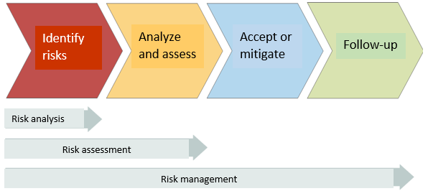
Risk Management
The sponsor conducts their risk assessment at a high level from “their“ perspective.
We are expected to perform a risk assessment at an operational level (a relatively detailed risk log), often in discussion with the Sponsor.
The result has an impact on:
The level of operational activities based on Roles&Responsibilities
Monitoring plan
Time allocation
The contract
etc.
The better we are at conducting risk assessments and managing those risks,
the fewer problems and surprises we will have to deal with in our daily work.
Notes:
Sponsor Risk Management plan:
To PROJECT
To CRO
To BUSINESS
To SCIENTIFIC

Slide 10
So, what should the Sponsor do?
Well-written and clear trial protocol
Carefully selected subcontractors – qualification visits, audits
Detailed contracts and clearly defined Roles & Responsibilities
"Trustworthy data": system to ensure data quality and integrity
  Validated electronic systems for data collection and processing
  Regular data review and verification
  Management of data discrepancies
Reporting obligations – more than just SUSARs:
  Serious Breach - Urgent safety measures – Other significant medical event - Adverse Events of Special Interest (AESI).
  Meeting timelines
  Accurate/correct reports at all levels.
Notes:
Risk-baserad approach
Risk Management plan:
To PROJECT
To CRO
To BUSINESS
To SCIENTIFIC

Slide 11

Serious Breach
No 536/2014, Article 52
MA/698382/2021: Guideline for the notification of serious breaches of Regulation (EU) No 536/2014 or the clinical trial protocol
An event likely to affect the safety and rights of a subject or the reliability and robustness of the data, in a significant way.
Sponsor's Responsibilities:
Have a SOP for Serious Breach
Determine what is a Serious Breach and report in CTIS within 7 calendar days
An "Important deviation" is not necessarily a Serious Breach and vice versa
Root cause analysis + corrective actions
Training of PI/site:
  How to recognize a suspected Serious Breach
  Reporting responsibilities and escalation path

Slide 12
Urgent Safety Measures
No 536/2014, Article 54: "Urgent safety measures“
Urgent safety measures taken to protect subjects
Sponsor's Responsibilities:
Report Urgent Safety Measures in CTIS within 7 calendar days
Training of PI/site:
  How to recognize an Urgent Safety Measure
  Reporting obligations and reporting pathways
Notes:
Artikel 53: ex medicineringsfel. GRAVIDITETER, , felanvändning, missbruk etc – omfattas av samma rapporteringsskyldighet som biverkningar.
The Important Medical Event Term List.
Identified AEs that by nature should be reported as Other Medical Important Event.

Slide 13
Other Important Medical Events
No 536/2014, Article 53 "Other reporting obligations relevant for subject safety“
Unforeseen events that may affect the benefit-risk balance, but which do not meet the definition of SUSARs (Article 42).
EMA’s Important Medical Event Term List: EudraVigilance system overview | European Medicines Agency (EMA) (europa.eu)
Sponsor's Responsibilities:
Report Other Medical Important Event in CTIS (not EudraVigilance) within 15 calendar days
Training of PI/site:
  How to recognize a suspected an Other Important Medical Event
  Reporting obligations and reporting pathways
Notes:
Artikel 53: ex medicineringsfel. GRAVIDITETER, , felanvändning, missbruk etc – omfattas av samma rapporteringsskyldighet som biverkningar.
The Important Medical Event Term List.
Identified AEs that by nature should be reported as Other Medical Important Event.

Slide 14
Adverse events of special interest (AESI)
ICH-E2F – Development of Safety Update Report.
An AESI is a specific adverse event that is carefully monitored and investigated due to its potential clinical significance or impact on patient safety.
Can be Serious or non-Serious
Sponsor's Responsibilities:
Regular assessment of AEs (“signal detection”) to identify AESI:s that may require immediate communication from the PI to the Sponsor
  More AEs within a category than expected
  Expected events that are more severe or have more severe consequences than expected.
Training of PI/site:
  Provide information on identified AESI’s
  Reporting obligations and reporting pathways
To be mentioned in the annual report/DSUR (ICH-E2E)
May need to be reported to authorities in CTIS as Important Medical Event (Article 53) or in EudraVigilance as SUSAR.
Notes:
These events are of particular interest to regulatory authorities, healthcare providers, and researchers, as they can provide valuable insights into the safety and efficacy of products, interventions, or processes.
AESI – extensively used for vaccines,
Event may end up in the RSI list.

Slide 15
Continued… What should Sponsor do?
Quality Management System (QMS)
  Risk Management Plan – overall risk assessment, regular revision
  Sponsor Oversight Plan - what should be done when and how will it be documented (meeting notes, trackers/logs, e-mails, reports)?
  Separate Sponsor Oversight File, to be attached to the study's TMF before archiving
  Oversight activities
  Review and approve the CRO's processes and plans for execution
  Review status reports
  Access to data and documents for sampling
  Communication
Notes:
Risk-baserad approach
Risk Management plan:
To PROJECT
To CRO
To BUSINESS
To SCIENTIFIC

Slide 16
Continued… What should Sponsor do?
A person must be appointed as responsible for ensuring that Sponsor Oversight is carried out.
Regular review of Deviation log for assessment and classification of deviations
  Is there need revision of instructions, training, CAPA...?
  Serious breach – reporting to authorities
Investigator oversight – training, IMP, compliance
Regular review of AEs to identify trends and AEs of Special Interest
Maintain a Problem / Action / Decision Log (one of many logs)
SOPs for all mentioned above
Notes:
Risk Management plan:
To PROJECT
To CRO
To BUSINESS
To SCIENTIFIC
Suspected serious breach: means an incident which at the time of communication from investigators or from service providers to the sponsor has not yet been assessed by the sponsor to be a serious breach.

Slide 17
Inspection readiness
Everyone needs to know their responsibilities from the start. Document what is needed to be able to "reconstruct" the study (activities, decisions, measures/actions, etc.).
It is difficult to reconstruct processes afterwards, so it is important to spend time on planning, to agree on and to write down the processes for the study early on.
An audit/inspection/due diligence "company visit" is announced about 2 weeks in advance, which gives little time for catch-up activitities.
During the inspection, requested documents/documentation must be readily available.

Slide 18
Inspection findings – teach us how to interpret the regulations
Examples from courses and lectures on Sponsor Oversight
QMS Missing Key Oversight procedures (Critical)
Inadequate Sponsor Oversight Plan (major)
Activities are not performed according to the Oversight Plan (major)
Insufficient documentation of overview (major)
No QC of TMF/eTMF (critical)
No follow-up on issues within a reasonable timeframe
Insufficient evidence of training or qualifications
Sponsor has no/poor access to study data
Sponsor has no/poor access to documentation
Unclear role distribution

Slide 19

Sponsor Oversight – my own observations
Plans are not being followed, updates not done consistently.
Updated SOPs at the CRO, which various study plans refer to, do not reach the Sponsor.
Incomplete handover.
Documented training is missing in connection with amendments, updated instructions, safety information etc.
Late changes in the CDB that should have triggered an SAE follow-up.
Missed SUSAR reporting due to poor knowledge of the content in the RSI table in IB.
Misunderstood instructions.
"Forgotten" queries in eCRF.

Slide 20

ICH-GCP E6, draft R3 – a glimpse of what is likely to come
3.6.9
The sponsor should have access to relevant information (e.g., SOPs and performance metrics) for selection and oversight of service providers.
3.6.10
The sponsor should ensure appropriate oversight of important trial-related activities that are transferred to service providers and further subcontracted.
3.6.12
.... In trials with more than one sponsor, the sponsors should have a documented agreement that sets out their respective responsibilities, in accordance with local regulatory requirements and/or practice...

Slide 21
ICH-GCP E6 draft R3, continued.
All of chapter 3.9
Summery:
The selection and oversight of investigators and service providers are fundamental features of the oversight process.
Oversight by the sponsor includes quality assurance and quality control processes relating to the trial-related activities of investigators and service providers.
Risk-based Quality Management approach
Emphasis on proportionality instead of unnecessary complexity of trial-related procedures
Clear Roles & Responsibilities.
Notes:
Balans mellan Ovesight och Micro Management.

Slide 22
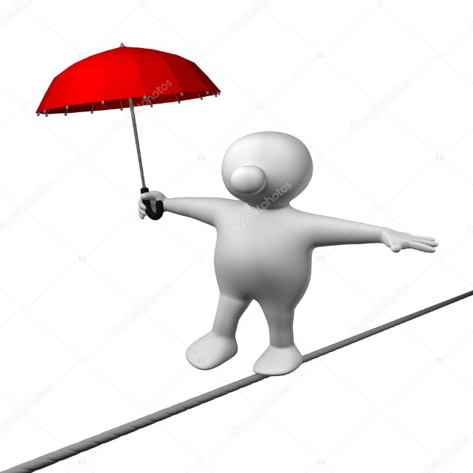

Oversight vs. Micro Management
Good Oversight is a combination of tools, processes, and people…
...a collaboration to...
To ensure safety and integrity of study subjects
To ensure robust data

Slide 23

Free training videos
https://www.pharmarelations.com
Academy
On demand

Slide 24


