Slide 1
Clinical Event Adjudication (CEA)
UCR
Anna Dahlstedt CEA PM/Coordinator

Slide 2
CLINICAL EVENT ADJUDICATION (CEA)
What is Adjudication and why do we do it?
It is an Independent, systematic and if possible blinded process to evaluate suspected endpoints according to the appropriate endpoint definitions in clinical studies
To ensure quality, reduce variability and achieve greater consistency of results within the country, between countries and for the study as a whole
For each suspected endpoint, relevant source documents are collected from sites
Independent physicians (reviewers) with clinical expertise in relevant therapeutic area review source data and make assessments based on standardized definitions (specified in the CEA Charter)
Adjudication should be seen as a quality label for the study

Slide 3
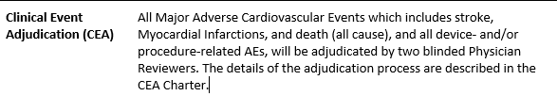
CEA Study specific documents
Study Protocol includes a short summary of CEA,
CEA Charter (endpoint definitions included)
CEA Operations manual
CEA Site manual

Slide 4
CEA roles at UCR
UCR
Co-chair
CEA Monitor
CEA Project Manager/Coordinator
CEA Administrator
CEA Chair
Physician Reviewers
Endpoint Office

Slide 5
CEA Process Flowchart
Event reported in eCRF
Query to site
Incomplete
Incomplete
Site uploads
Transmittal form and source documents to CEA
CEA collects source documents and performs a quality control. In most studies relevant eCRF information is included in the event package
CEA submits event package for adjudication
Complete
Adjudication
Site
CEA PM/Coordinator
EPO
Reviewers

Slide 6

CEA process
Site records new clinical event
Collection of source documents
CEA office
data check
Event package - final review by CEA coordinator
Event package submitted to two physicans for review
Endpoint identification through registries
Incomplete source data
Query sent to site
Adjudication
Adjudication
Database adjudicated events
Disagreements resolved at Phase II meeting or other solutions

Slide 7
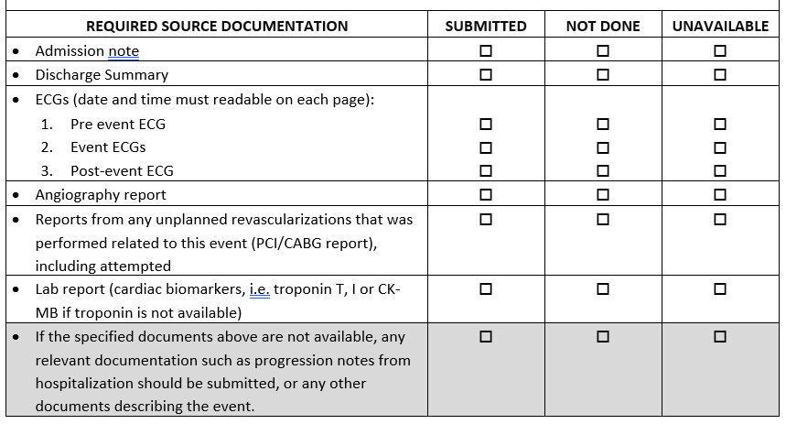
Examples of requested source data, Cardiac ischemic event

Slide 8
Actions to be performed by site
Copies of medical record to be submitted according to instructions in the CEA Site manual
Each suspected endpoint is given a specific event tracking number and each source document page should be labelled with this specific number
All Personally Identifiable Information (PII) should be redacted
Relevant source document for the reported suspected endpoint
Lab reports including unit and reference values (differs between hospitals)
CRA important, communicate with site and CEA, assist site with queries
Queries: pages are not labelled with event tracking number, we are asking for a specific ECG, date missing for when medical note is written (e.g date not visible on discharge summary)

Slide 9
Challenges with CEA
Sensitive information, medical records (pseudonymised), to be transferred outside hospitals
Time consuming for site personnel
Estimation of number of events to be expected in the study

Slide 10
Questions?

Slide 11


