Slide 1
MORE THAN 20 YEARS OF EVIDENCE-BASED IMPROVEMENT OF HEALTHCARE

Slide 2
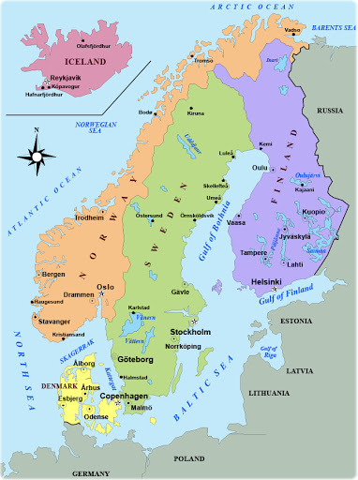
MORE THAN 20 YEARS OF EVIDENCE-BASED IMPROVEMENT OF HEALTHCARE
Welcome to Uppsala!

Slide 3
An introduction to Uppsala Clinical Research Center (UCR)
Maria Sörby, PhD
Head of section, Clinical Research Section

Slide 4
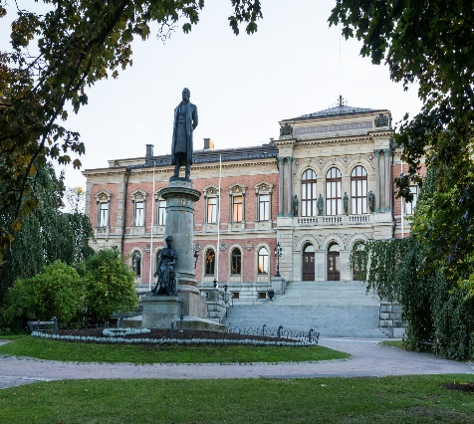
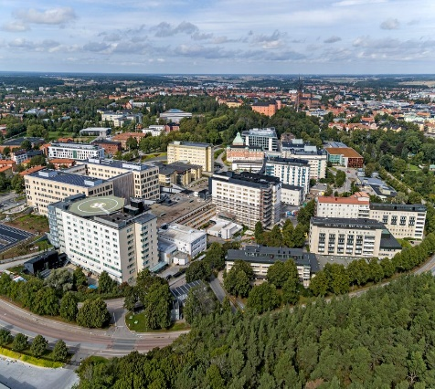
Uppsala Clinical Research Center- a (non-profit) competence centre for clinical research
As so often within academia – the UCR journey was started
by a driving force. An enthusiast with a strong vision.
This is Lars Wallentin
Cardiologist and Professor of Cardiology
In 1992 he started the Swedish Registry of Acute Cardiac Care (RIK-HIA).
In 2001, he founded the Uppsala Clinical Research Center and was Director until 2008.

Slide 5
Uppsala Clinical Research Center- a (non-profit) competence centre for clinical research
Since our start as a research center within Uppsala University and Uppsala University Hospital in 2001, UCR has established a complete full-service package, and offers academic, clinical, technical. and legal expertise.
UCR is the leading clinical academic research organization (ARO) in Sweden, providing in-house expertise to academia and industry on all aspects of clinical research and improved health care.
UCR has the competence and the technology to transform innovative ideas into translational research projects, clinical trials, observational studies, and
registry-based improvement projects.
The major part of our operations is financed via our assignments–a smaller part by grants from Uppsala University and Region Uppsala

Slide 6
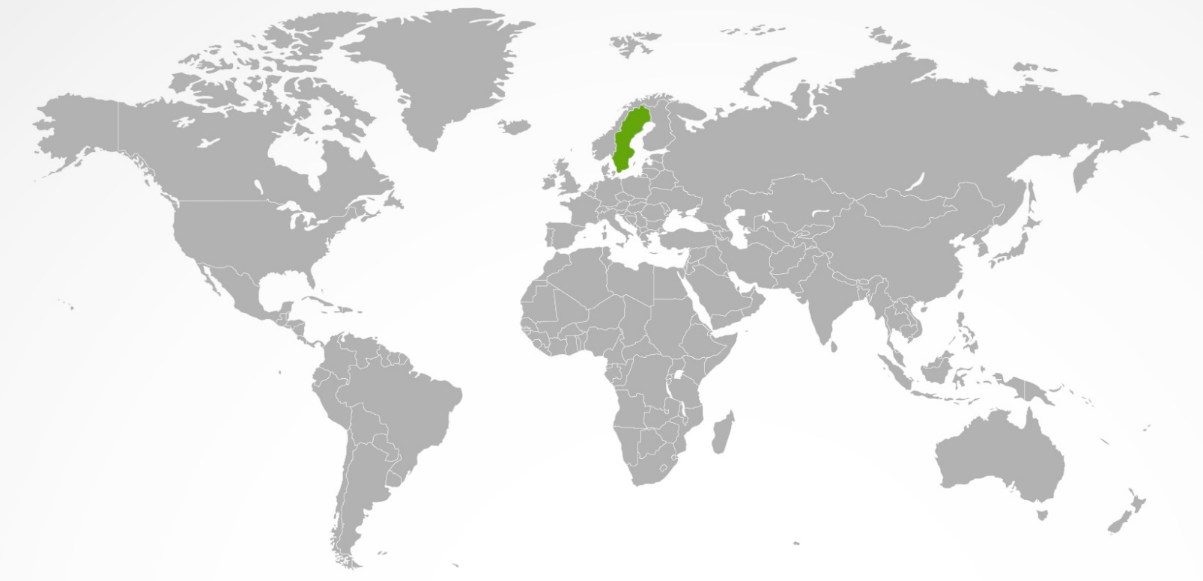
UCR is a mission-based organization
Our mission describes what we live for, are passionate about, driven by, and believe in as an organizarion and as individuals.
We are proud of our work that has contributed to IMPROVE HUMAN HEALTH IN SWEDEN AND WORLDWIDE, and we will continue our efforts to advance medical knowledge and health through clinical research and quality improvement.
Notes:
OK

Slide 7
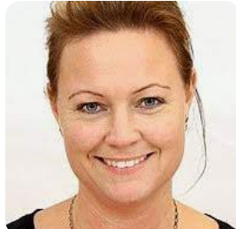
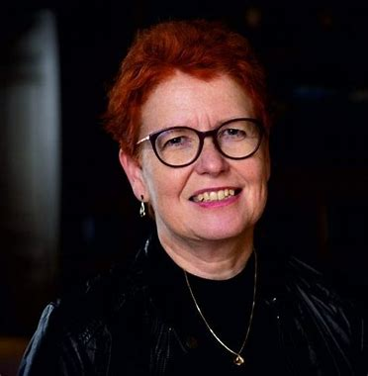
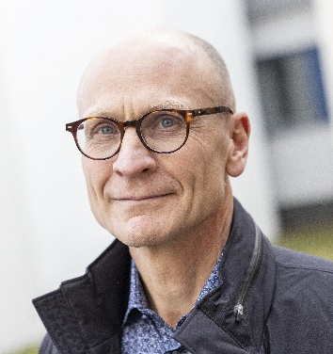
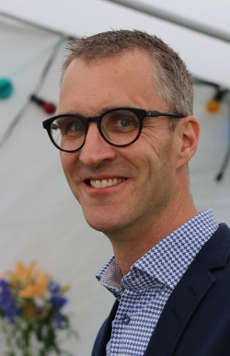
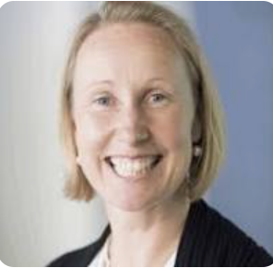
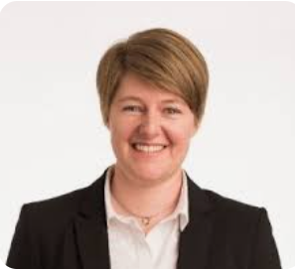
The management team
Johan Lindbäck
Katarina Durk Boustedt
Biostatistics
Scientific leaders
Support
Clinical Research
Quality
Registers
Maria Eriksson Svensson
QA
Research groups
Stefan James
(Cardiology)
Jakob Hedberg
(Cancer)
Maria Sörby
Sara Hansson
Jessica Magnusson
Notes:
These are our cor areas - clinical reserach, clinical quality registries in health care, and large scale biobanking and biomarker analyses.
Combining academic, clinical and technical expertise in one organisation creates an unique millieu for innovative projects.

Slide 8
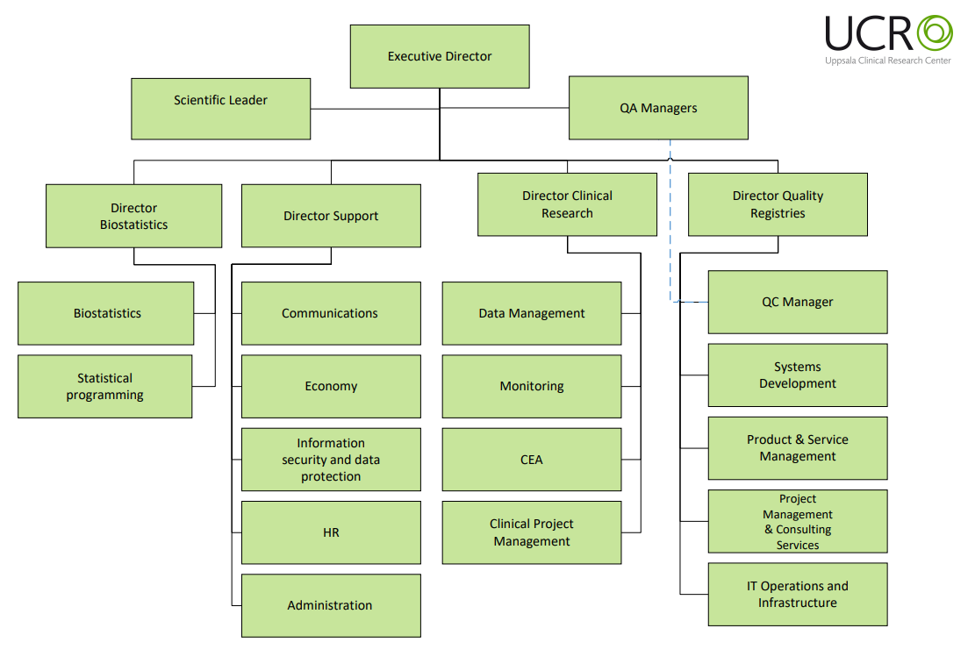
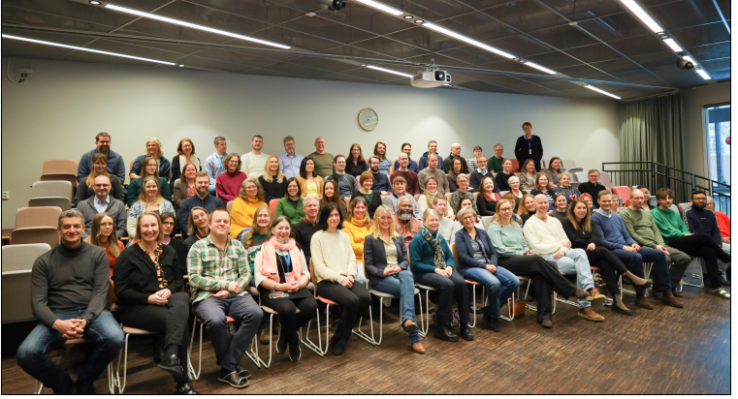
We are altogether 130 employees that support clinical research and improve health care

Slide 9
Clinical Quality Registries
Notes:
Befor describing our work with clinical trials and clinical studies – I will just give you a brief introduction to our work with clinical quality registries

Slide 10
The Swedish Clinical Quality Registries
A system of >100 National Quality Registers provides Swedish healthcare with unique opportunities to monitor quality and results
– systemic follow up on outcome of health care.
Notes:
Many hospitals and healthcare facilities in the world are still lacking means of systematic follow up on outcome
Registries with full national coverage established in very few countries, and in some medical areas only

Slide 11
Clinical Quality Registries at UCR - UCR being the largest registry organisation in Sweden
AURICULA* Nationellt register för förmaksflimmer och antikoagulation
GallRiks* Svenskt kvalitetsregister för gallstenskirurgi
KABL* Nationellt kvalitetsregister för Kateterbehandling vid hjärtrusningar
NRS* Nationella Registret över Smärtrehabilitering
RiksSvikt* Nationellt kvalitetsregister för hjärtsvikt
Rikssår* Nationellt kvalitetsregister för svårläkta sår
Senior Alert* Nationellt kvalitetsregister för vård och omsorg av äldre
SOReg* Scandinavian Obesity Surgery Registry
SPAHR* Svenskt register för pulmonell hypertension
SPOR* Svenskt Perioperativt Register
Svedem* Svenska Demensregistret
SWEDCON* Nationellt register för medfödda hjärtsjukdomar
SWEDEHEART* RIKS-HIA, SEPHIA, SCAAR,TAVI, HKIR och Kardiogenetikregistret
SWEDEVOX* Andningssviktregistret (oxygenbehandling och respiratorbehandling i hemmet)
SWEDVASC* Nationellt register för kärlkirurgi
TBI Traumatic Brain Injury Registry
ThoR Register för allmän Thoraxkirurgi
SwedCampP Register för kardiomyopati
SRIR Radiologiskt interventionsregister
SVAR Svenskt Akutvårdsregister
*Nationellt kvalitetsregister med stöd från Sveriges Kommuner och Landsting (SKR)
Notes:
RIKS-HIA – register över akut hjärtinfarktsvård
SEPHIA – register över sekundärpreventiv vård efter hjärtinfarkt
SCAAR – register över kateterburna kranskärlsingrepp
TAVI – register över kateterburna klaffbyten
Svenska Hjärtkirurgiregistret – register över öppna hjärtkirurgiingrepp
Kardiogenetikregistret – Svenskt register för ärftliga hjärtsjukdomar

Slide 12
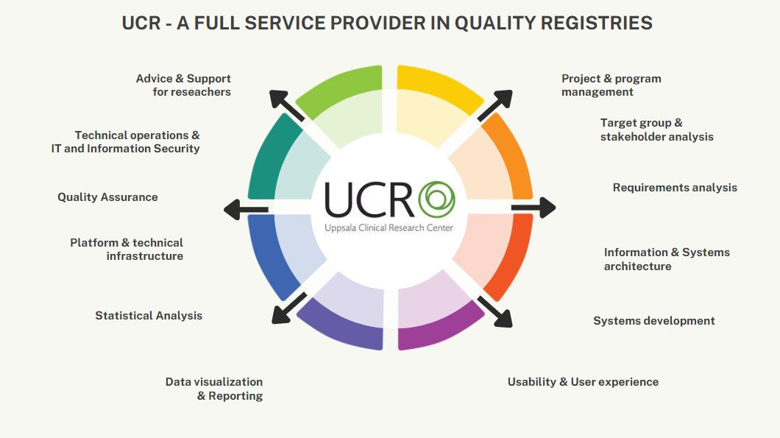

Slide 13
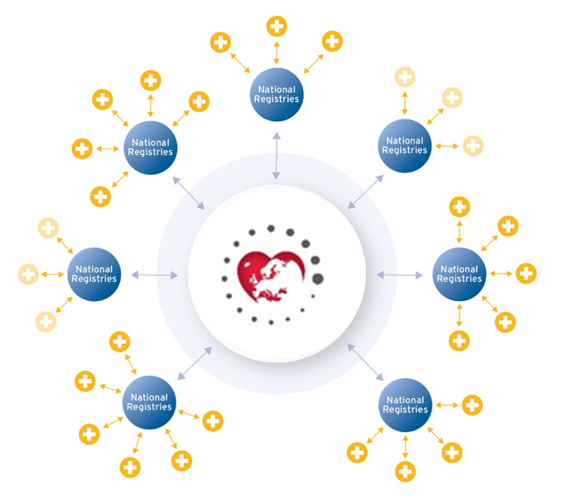
EuroHeart – Why and How
Improve the quality of cardiovascular care across Europe
Support high-quality and inclusive observational and randomized research
By developing and maintaining an international collaboration of countries with continuous online registration of high-quality, harmonised patient data at admission and over time.
By creating an international infrastructure for cost-effective safety surveillance of new drugs and devices and registry-based randomised clinical trials in a representative patient population across multiple geographies.
Notes:
Lars

Slide 14
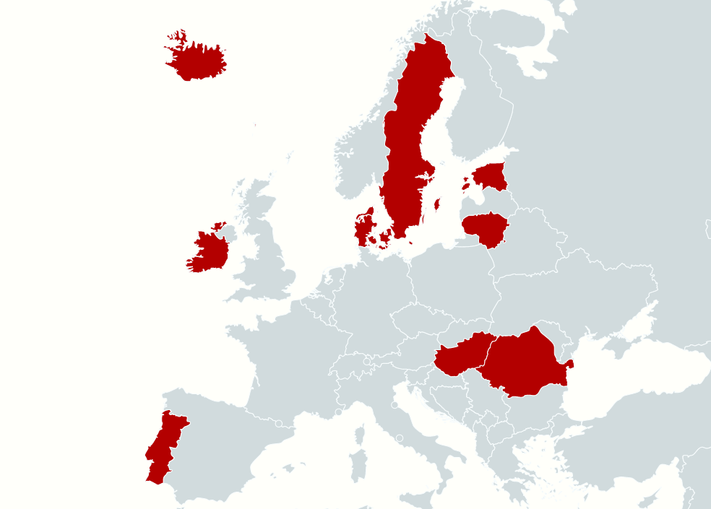
What countries are we working with?
Iceland
Estonia EHRC
Estonia EHRC located in Tartu.
ACS-PCI-registry since May 2021.
Currently 1 hospital (Tartu), planning on expanding to others during 2023.
April 2023.
HF-registry, roll-out to 5 hospitals fall/winter 2023/24.
Ireland EHRC
Ireland EHRC located in Cork.
Will include hospitals in the South/South West health care region to start with. Preparations in Ireland ongoing, implementation project to start September/October 2023.
Sweden
Denmark
Estonia
Lithuania EHRC
Lithuania EHRC to be located in Vilnius. The implementation was paused in March 2022 due to the Russian invasion of Ukraine. It is currently scheduled to restart in November 2023.
Lithuania
Ireland
Hungary
Other countries The other countries marked on the map have their own quality registers. They have agreed to harmonize their variables with those defined by EuroHeart in order to be able to compare quality of care and participate in future research projects initiated by EuroHeart/ESC.
Portugal
Romania
Romania EHRC
Romania EHRC located in Bucharest. ACS-PCI-registry since November 2021.
Currently 15 hospitals.
Created with mapchart.net
Notes:
Håkan

Slide 15
Clinical Research and Biostatistics

Slide 17
We can support from start to finish
Idea Design and planning
Conduct and operations
Study Close-out
Project management
Project plan
Safety management
Study closure activities
Site and investigator agreements
Medical writing
Protocol
Publication
Submission/Ethical review
Data Management
eCRF / paper-CRF
Study report
Clinical Database
Clinical Event Adjudication (CEA)
Monitoring
Monitoring plan
CRA training
Study quality control
Biostatistics
Study design
Reporting
Statistical analysis plan
Analysis

Slide 18
We can support from start to finish
Idea Design and planning
Conduct and operations
Study Close-out
Project management
Project plan
Safety management
Study closure activities
Site and investigator agreements
Medical writing
Protocol
Publication
Submission/Ethical review
Data Management
eCRF / paper-CRF
Study report
Clinical Database
Clinical Event Adjudication (CEA)
Monitoring
Monitoring plan
CRA training
Study quality control
Biostatistics
Study design
Reporting
Statistical analysis plan
Analysis

Slide 19
Who we are
QA
Clinical Research Section
Clinical Project Management
Monitoring
Data Management
Clinical Event Adjudication (CEA)
Publication Management / Medical Writing
Clinical Project Managers (CPM)
Coordinate, lead, and report all parts of a clinical study / project in accordance with budget, schedule, study protocols, standards / guidelines, SOP’s
Development of Study Protocols and applications to RA/EC
Advice/Consultations to academic researchers and industry
Training
CRAs/monitors
Site management
Quality assurance of data and the process for collecting / handling data: - Monitoring (SSV, SIV, MV, COV) - Source data verification / SDV
Collecting and filing of study documents prior to study start and during the conduct of the study
Training
Data Managers (DM)
EDC systems: - Viedoc, MACRO, Ethical/eAdjudication - REDCap – installation + Superuser function (2020) , Validated (2024)
eCRF/paper CRF
Builds databases, validation + documentation
Programming of logical controls
Import/export of data (eg registries, lab, to Sponsor)
CEA Project Managers/ Coordinators, CEA Monitors, CEA Administrators
Systematic and independent review of medical events in clinical trials
Notes:
Clinical Event Adjudication CEA is about independent classification so-called adjudication of clinical events. For each clinical event, relevant medical records are collected, such as ECGs and lab reports, and converted into electronic "event packages" which are then reviewed by specialists. Each individual event is examined independently by two physicians who classify according to predetermined study-specific definitions.
UCR has extensive experience and well-established routines to be able to help our customers meet the authorities' requirements. We use an electronic web-based system that makes the process user-friendly, efficient and secure in both small and large clinical studies. Since 2007, UCR has conducted more than 50,000 adjudications. THEMIS – closed in February 2019. 1045 sites, 45 countries, 19 000 pat’s included, 8000 events adjudicated by UCR
Data management in clinical trials and research is a strictly regulated area. UCR was one of the first to be certified for data management within the European Clinical Research Infrastructure Network, ECRIN. Our data managers have extensive experience of all aspects of data management in clinical trials, such as

Slide 20
Biostatisticians role in the clinical trial
Planing
Start-Up
Conduct
Analysis
Designing
Conducting
Analyzing
Reporting
Minimizing biases
Confounding factors
Measuring random errors
Understanding the research
Make suggestions on hypothesis testing & analysis
Calculating the sample size
Determine the power of the study
Ensure continuity throughout the research
Assess the statistical significance of the results
Efficacy & safety of the drug
Line of treatment
Therapy
Notes:
Highlighting the importance of statical competence in a study!

Slide 21
For clinical researchers, UCR offer a wealth of support available for each step of the research process
Starting up your research project, designing your study protocol in a way that responds to your question and at the same time is both practical and regulatory feasible
Applying for research funding, competitive applications for research funds, including calculation of patient numbers (power)
Submit to authorities Clinical Trials Information System (CTIS), Swedish Medical Products Agency, Swedish Ethial Review Authority
Research in progress (trial management, monitoring, randomization, data management)
Publishing your research
Disseminating and utilising findings
Reporting, closing and storing your project (data)

Slide 22
Who are our clients?
Academic Research Institutions
Pharmaceutical companies
Medical Device companies
Investigator-initiated studies
International multicenter trials
”All” therapeutic areas and indications

Slide 23
UCR provides in-house expertise regarding different types of clinical studies…
Observational studies (Real-world studies)
Clinical trials
Medical device studies
RCT – Randomized Clinical Trial
R-RCT – Registry-based Randomized Clinical Trial
DCT – Decentralised Clinical Trials
Notes:
Världsledande på R-RCT-konceptet Flera R-RCT som utförts vid UCR har lett till omedelbara och viktiga ändringar i internationella riktlinjer för behandling och emellanåt möjlighet till stora ekonomiska besparingar.

Slide 24
To summarize: UCR offers a complete research package
Our aim is to support qualified clinical research to improve health
and healthcare practice.
UCR is the largest of the six Swedish centers for National Clinical Quality Registries. We develop and support the national and local quality registries we manage, but we also provide register-related competence and technology to international stakeholders.
UCR has the experience and the competence
needed to plan, conduct, analyze, report,
and publish local investigator-initiated studies
to international multicenter trials.
Scientific leadership
Biostatistics
Project management
Data management
Monitoring
Medical Writing
Publication management
Clinical event adjudication (CEA)
Quality registry services
Notes:
These are our cor areas - clinical reserach, clinical quality registries in health care, and large scale biobanking and biomarker analyses.
Combining academic, clinical and technical expertise in one organisation creates an unique millieu for innovative projects.

